Slide 1

Database Systems:
Design, Implementation, and Management
Tenth Edition
Chapter 11
Database Performance Tuning and Query Optimization

Slide 2
Objectives
In this chapter, you will learn:
Basic database performance-tuning concepts
How a DBMS processes SQL queries
About the importance of indexes in query processing
Database Systems, 10th Edition

Slide 3
Objectives (cont’d.)
About the types of decisions the query optimizer has to make
Some common practices used to write efficient SQL code
How to formulate queries and tune the DBMS for optimal performance
Database Systems, 10th Edition

Slide 4

Database Performance-Tuning Concepts
Goal of database performance is to execute queries as fast as possible
Database performance tuning
  Set of activities and procedures designed to reduce response time of database system
All factors must operate at optimum level with minimal bottlenecks
Good database performance starts with good database design
Database Systems, 10th Edition

Slide 5
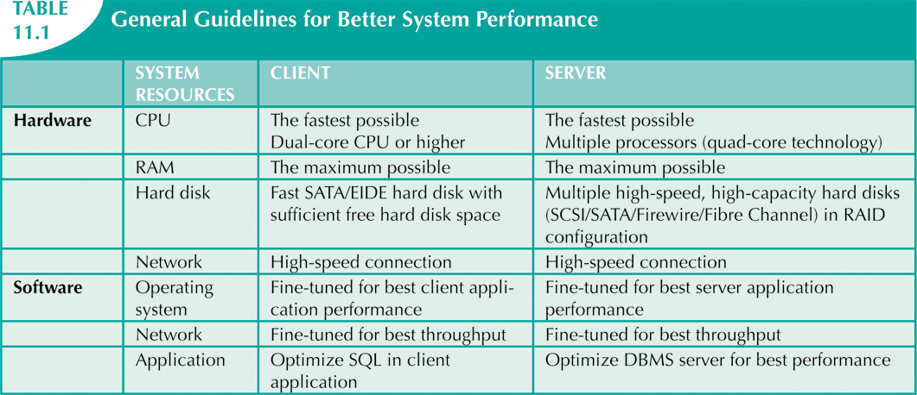
Database Systems, 10th Edition

Slide 6
Performance Tuning:
Client and Server
Client side
  Generate SQL query that returns correct answer in least amount of time
    Using minimum amount of resources at server
  SQL performance tuning
Server side
  DBMS environment configured to respond to clients’ requests as fast as possible
    Optimum use of existing resources
  DBMS performance tuning
Database Systems, 10th Edition

Slide 7
DBMS Architecture
All data in database are stored in data files
Data files
  Automatically expand in predefined increments known as extends
  Grouped in file groups or table spaces
Table space or file group
  Logical grouping of several data files that store data with similar characteristics
Database Systems, 10th Edition

Slide 8
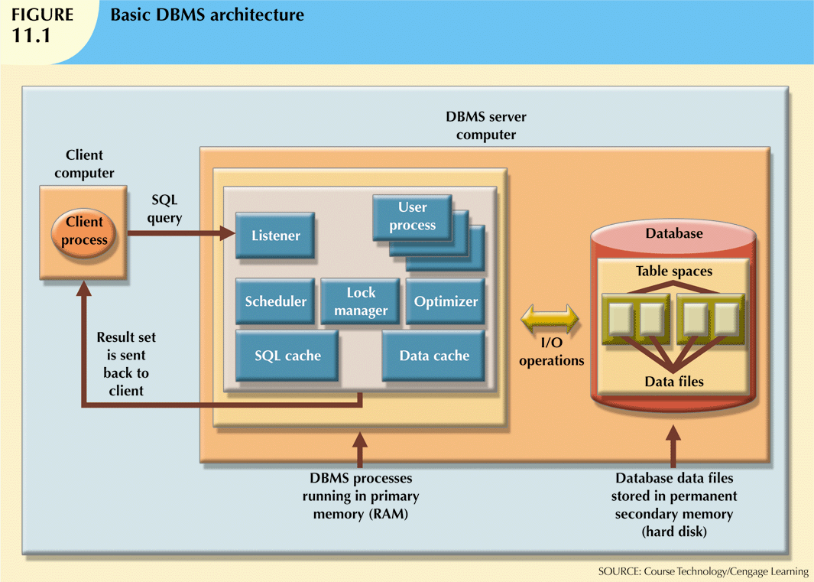
Database Systems, 10th Edition

Slide 9
DBMS Architecture (cont’d.)
Data cache or buffer cache: shared, reserved memory area
  Stores most recently accessed data blocks in RAM
SQL cache or procedure cache: stores most recently executed SQL statements
  Also PL/SQL procedures, including triggers and functions
DBMS retrieves data from permanent storage and places it in RAM
Database Systems, 10th Edition

Slide 10
DBMS Architecture (cont’d.)
Input/output request: low-level data access operation to/from computer devices
Data cache is faster than data in data files
  DBMS does not wait for hard disk to retrieve data
Majority of performance-tuning activities focus on minimizing I/O operations
Typical DBMS processes:
  Listener, user, scheduler, lock manager, optimizer
Database Systems, 10th Edition

Slide 11
Database Query Optimization Modes
Automatic query optimization
  DBMS finds the most cost-effective access path without user intervention
Manual query optimization
  Requires that the optimization be selected and scheduled by the end user or programmer
Static query optimization
  Takes place at compilation time
Dynamic query optimization
  Takes place at execution time
Database Systems, 10th Edition

Slide 12
Database Query Optimization Modes (cont’d.)
Statistically based query optimization algorithm
  Uses statistical information about the database
  Dynamic statistical generation mode
  Manual statistical generation mode
Rule-based query optimization algorithm
  Based on a set of user-defined rules to determine the best query access strategy
Database Systems, 10th Edition

Slide 13
Database Statistics
Measurements about database objects and available resources:
  Tables
  Indexes
  Number of processors used
  Processor speed
  Temporary space available
Database Systems, 10th Edition

Slide 14
Database Statistics (cont’d.)
Make critical decisions about improving query processing efficiency
Can be gathered manually by DBA or automatically by DBMS
Database Systems, 10th Edition

Slide 15
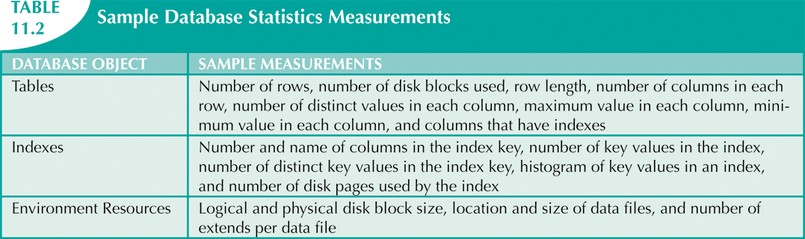
Database Systems, 10th Edition

Slide 16
Query Processing
DBMS processes queries in three phases
  Parsing
    DBMS parses the query and chooses the most efficient access/execution plan
  Execution
    DBMS executes the query using chosen execution plan
  Fetching
    DBMS fetches the data and sends the result back to the client
Database Systems, 10th Edition

Slide 17
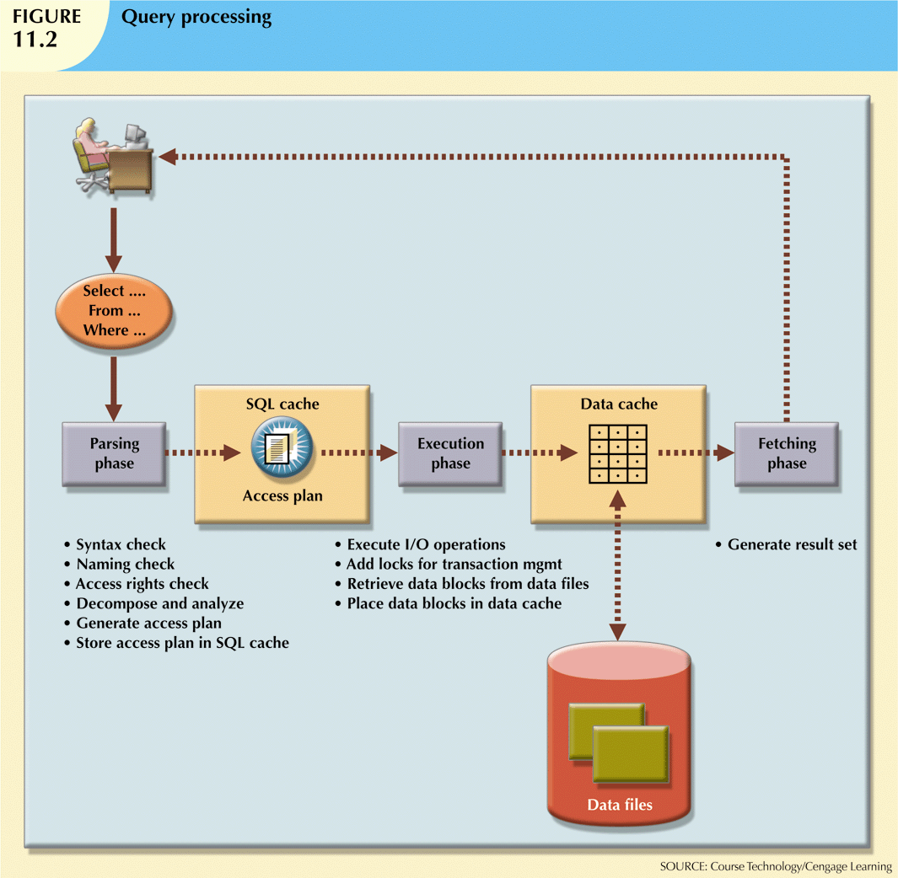
Database Systems, 10th Edition

Slide 18
SQL Parsing Phase
Break down query into smaller units
Transform original SQL query into slightly different version of original SQL code
  Fully equivalent
    Optimized query results are always the same as original query
  More efficient
    Optimized query will almost always execute faster than original query
Database Systems, 10th Edition

Slide 19
SQL Parsing Phase (cont’d.)
Query optimizer analyzes SQL query and finds most efficient way to access data
  Validated for syntax compliance
  Validated against data dictionary
    Tables and column names are correct
    User has proper access rights
  Analyzed and decomposed into components
  Optimized
  Prepared for execution
Database Systems, 10th Edition

Slide 20
SQL Parsing Phase (cont’d.)
Access plans are DBMS-specific
  Translate client’s SQL query into a series of complex I/O operations
  Required to read the data from the physical data files and generate result set
DBMS checks if access plan already exists for query in SQL cache
DBMS reuses the access plan to save time
If not, optimizer evaluates various plans
  Chosen plan placed in SQL cache
Database Systems, 10th Edition

Slide 21
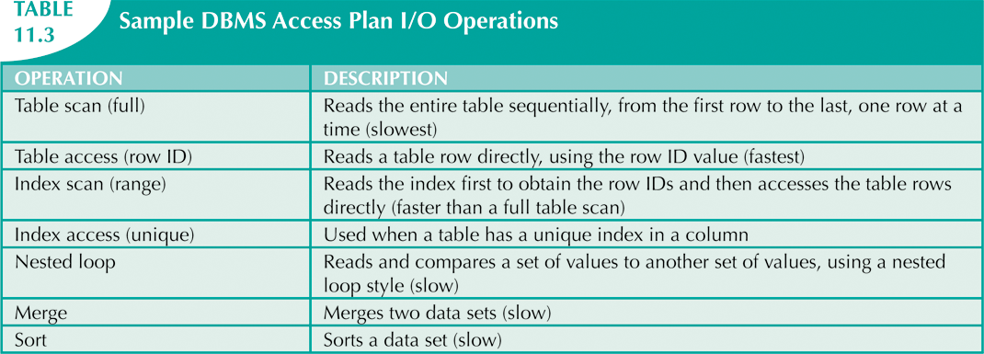
Database Systems, 10th Edition

Slide 22
SQL Execution Phase
SQL Fetching Phase
All I/O operations indicated in access plan are executed
  Locks acquired
  Data retrieved and placed in data cache
  Transaction management commands processed
Rows of resulting query result set are returned to client
DBMS may use temporary table space to store temporary data
Database Systems, 10th Edition

Slide 23
Query Processing Bottlenecks
Delay introduced in the processing of an I/O operation that slows the system
  CPU
  RAM
  Hard disk
  Network
  Application code
Database Systems, 10th Edition

Slide 24
Indexes and Query Optimization
Indexes
  Crucial in speeding up data access
  Facilitate searching, sorting, and using aggregate functions as well as join operations
  Ordered set of values that contains index key and pointers
More efficient to use index to access table than to scan all rows in table sequentially
Database Systems, 10th Edition

Slide 25
Indexes and Query Optimization (cont’d.)
Data sparsity: number of different values a column could possibly have
Indexes implemented using:
  Hash indexes
  B-tree indexes
  Bitmap indexes
DBMSs determine best type of index to use
Database Systems, 10th Edition

Slide 26
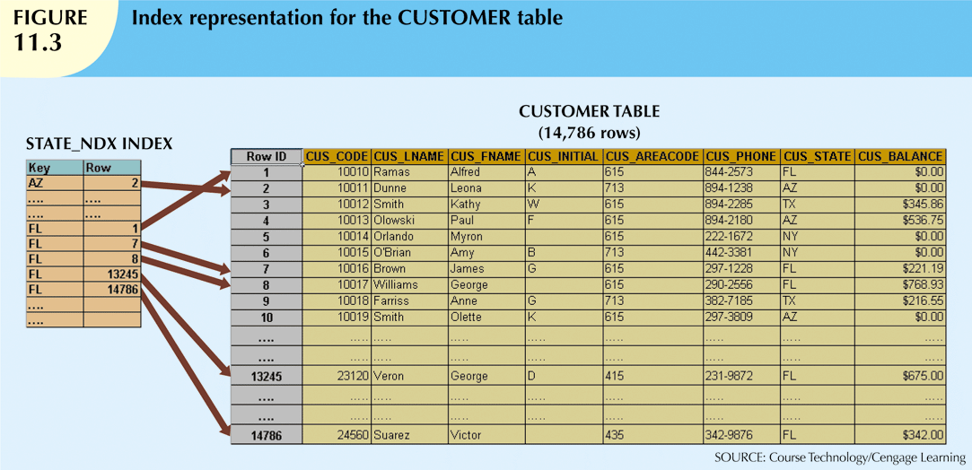
Database Systems, 10th Edition

Slide 27
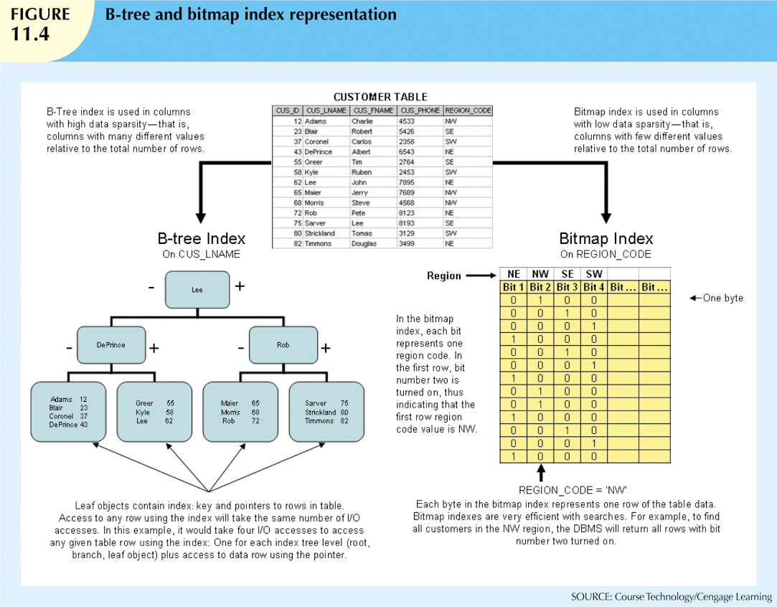
Database Systems, 10th Edition

Slide 28
Optimizer Choices
Rule-based optimizer
  Preset rules and points
  Rules assign a fixed cost to each operation
Cost-based optimizer
  Algorithms based on statistics about objects being accessed
  Adds up processing cost, I/O costs, resource costs to derive total cost
Database Systems, 10th Edition

Slide 29
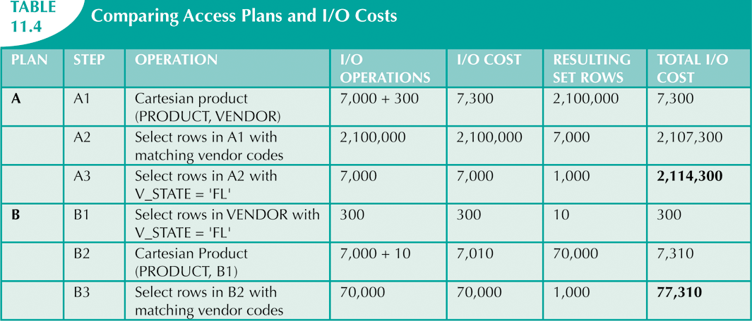
Database Systems, 10th Edition

Slide 30
Using Hints to Affect
Optimizer Choices
Optimizer might not choose best plan
Makes decisions based on existing statistics
  Statistics may be old
  Might choose less-efficient decisions
Optimizer hints: special instructions for the optimizer embedded in the SQL command text
Database Systems, 10th Edition

Slide 31
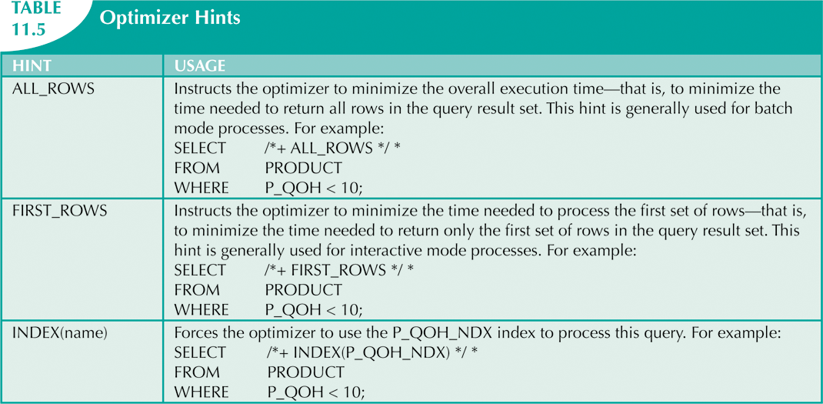
Database Systems, 10th Edition

Slide 32

SQL Performance Tuning
Evaluated from client perspective
  Most current relational DBMSs perform automatic query optimization at the server end
  Most SQL performance optimization techniques are DBMS-specific
    Rarely portable
Majority of performance problems are related to poorly written SQL code
Carefully written query usually outperforms a poorly written query
Database Systems, 10th Edition

Slide 33
Index Selectivity
Indexes are used when:
  Indexed column appears by itself in search criteria of WHERE or HAVING clause
  Indexed column appears by itself in GROUP BY or ORDER BY clause
  MAX or MIN function is applied to indexed column
  Data sparsity on indexed column is high
Measure of how likely an index will be used
Database Systems, 10th Edition

Slide 34
Index Selectivity (cont’d.)
General guidelines for indexes:
  Create indexes for each attribute in WHERE, HAVING, ORDER BY, or GROUP BY clause
  Do not use in small tables or tables with low sparsity
  Declare primary and foreign keys so optimizer can use indexes in join operations
  Declare indexes in join columns other than PK/FK
Database Systems, 10th Edition

Slide 35
Conditional Expressions
Normally expressed within WHERE or HAVING clauses of SQL statement
Restricts output of query to only rows matching conditional criteria
Database Systems, 10th Edition

Slide 36
Conditional Expressions (cont’d.)
Common practices for efficient SQL:
  Use simple columns or literals in conditionals
  Numeric field comparisons are faster
  Equality comparisons are faster than inequality
  Transform conditional expressions to use literals
  Write equality conditions first
  AND: use condition most likely to be false first
  OR: use condition most likely to be true first
  Avoid NOT
Database Systems, 10th Edition

Slide 37
Query Formulation
Identify what columns and computations are required
Identify source tables
Determine how to join tables
Determine what selection criteria is needed
Determine in what order to display output
Database Systems, 10th Edition

Slide 38
DBMS Performance Tuning
Includes managing DBMS processes in primary memory and structures in physical storage
DBMS performance tuning at server end focuses on setting parameters used for the:
  Data cache
  SQL cache
  Sort cache
  Optimizer mode
Database Systems, 10th Edition

Slide 39
DBMS Performance Tuning (cont’d.)
Some general recommendations for creation of databases:
  Use RAID (Redundant Array of Independent Disks) to provide balance between performance and fault tolerance
  Minimize disk contention
  Put high-usage tables in their own table spaces
  Assign separate data files in separate storage volumes for indexes, system, and high-usage tables
Database Systems, 10th Edition

Slide 40
DBMS Performance Tuning (cont’d.)
  Take advantage of table storage organizations in database
  Partition tables based on usage
  Use denormalized tables where appropriate
  Store computed and aggregate attributes in tables
Database Systems, 10th Edition

Slide 41
Query Optimization Example
Example illustrates how query optimizer works
Based on QOVENDOR and QOPRODUCT tables
Uses Oracle SQL*Plus
Database Systems, 10th Edition

Slide 42
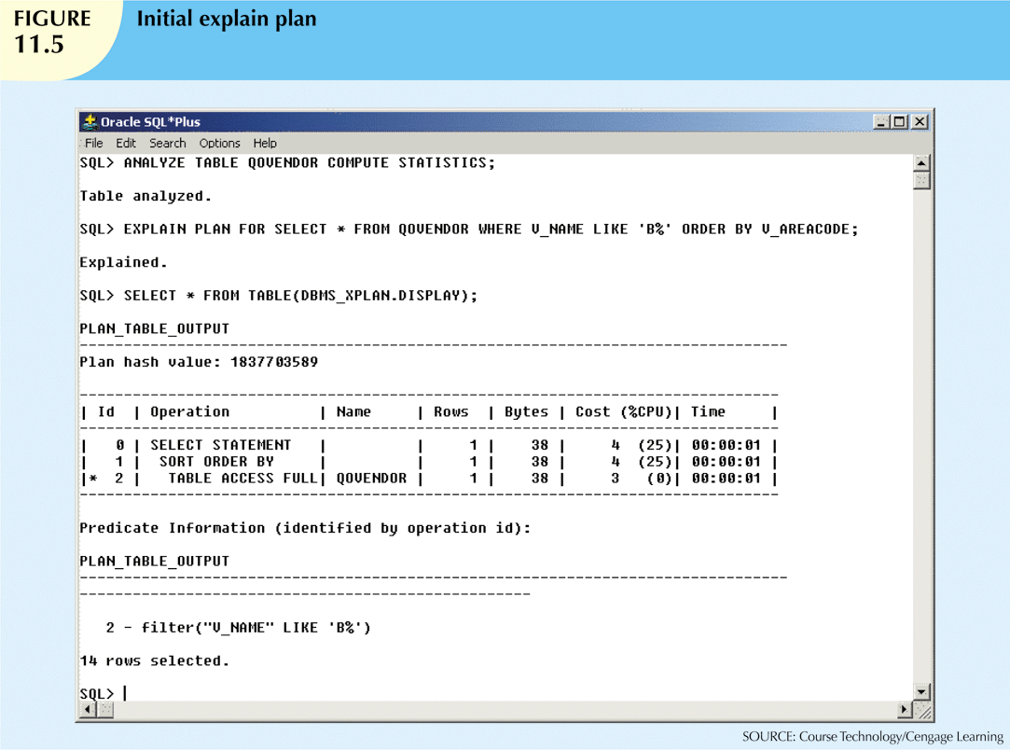
Database Systems, 10th Edition

Slide 43
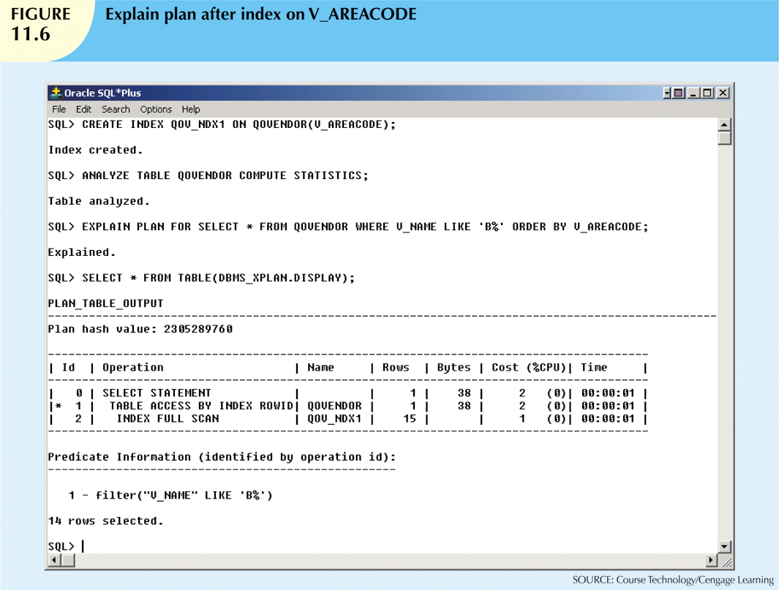
Database Systems, 10th Edition

Slide 44
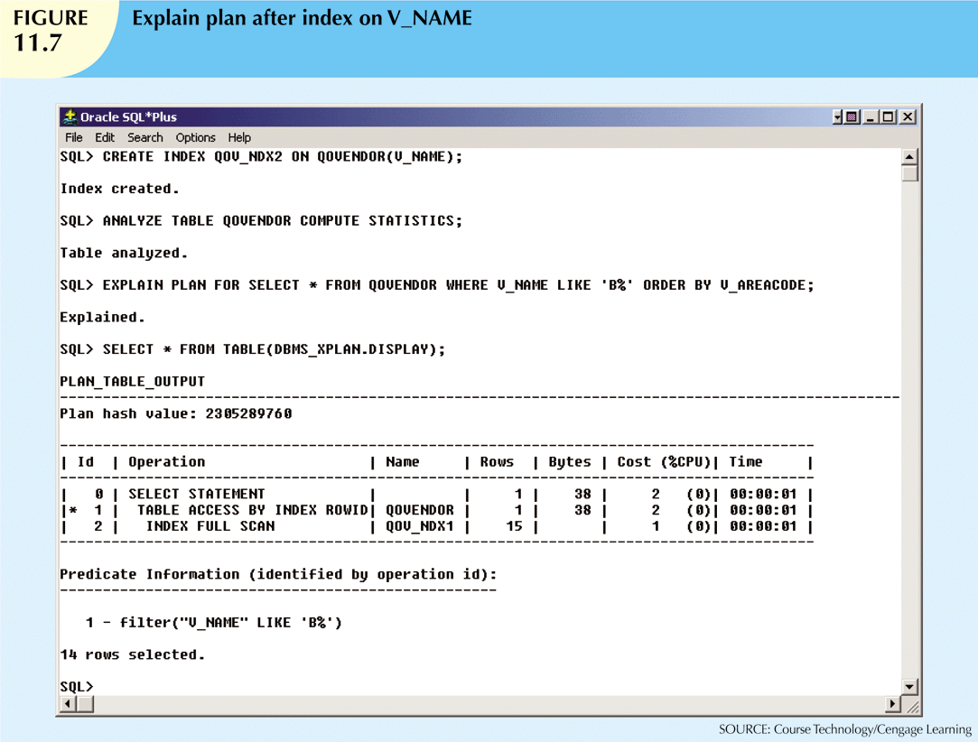
Database Systems, 10th Edition

Slide 45
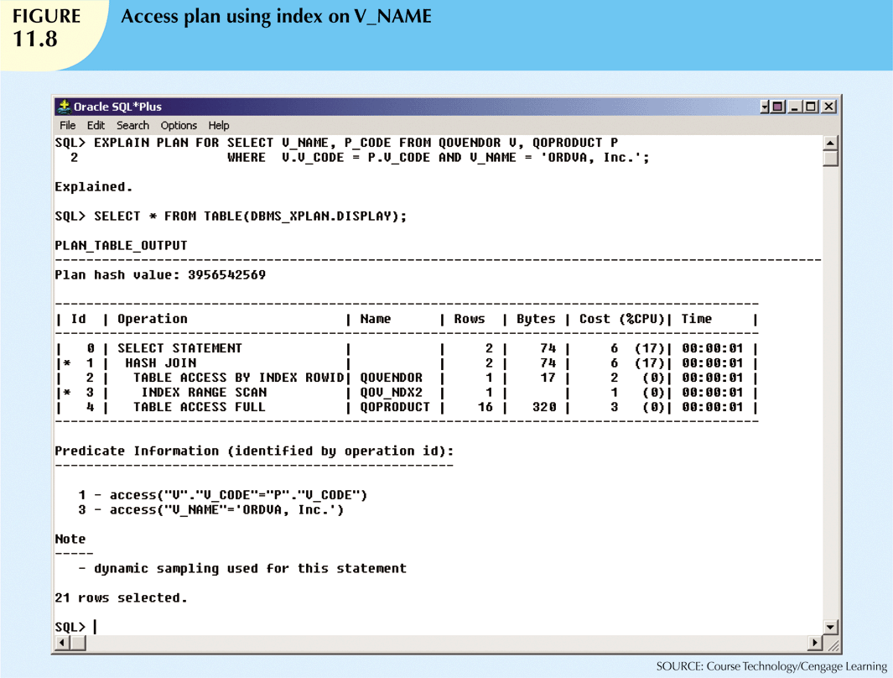
Database Systems, 10th Edition

Slide 46
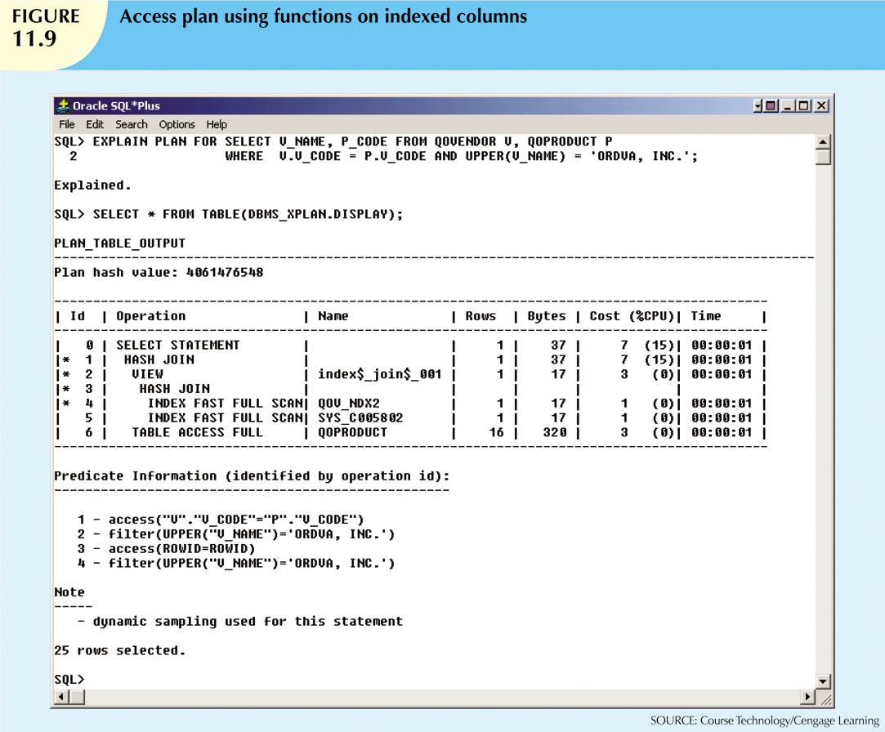
Database Systems, 10th Edition

Slide 47
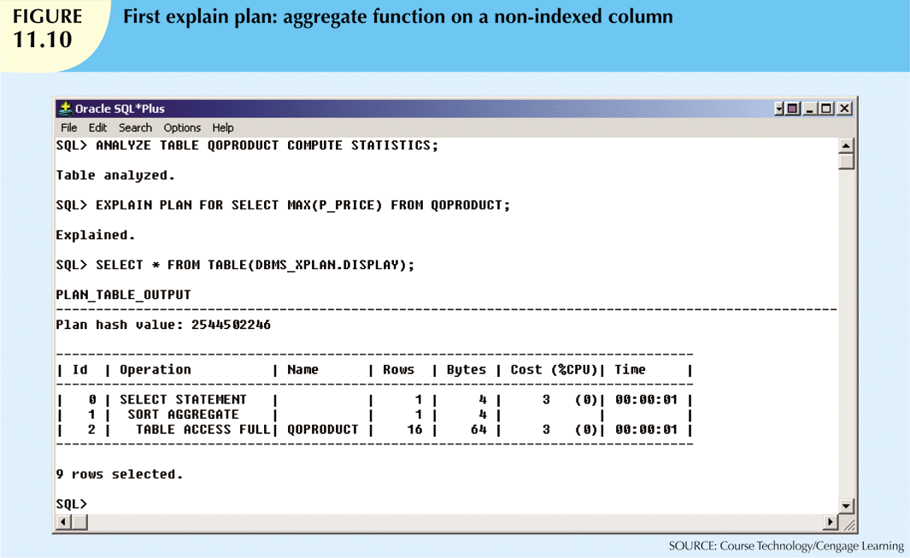
Database Systems, 10th Edition

Slide 48
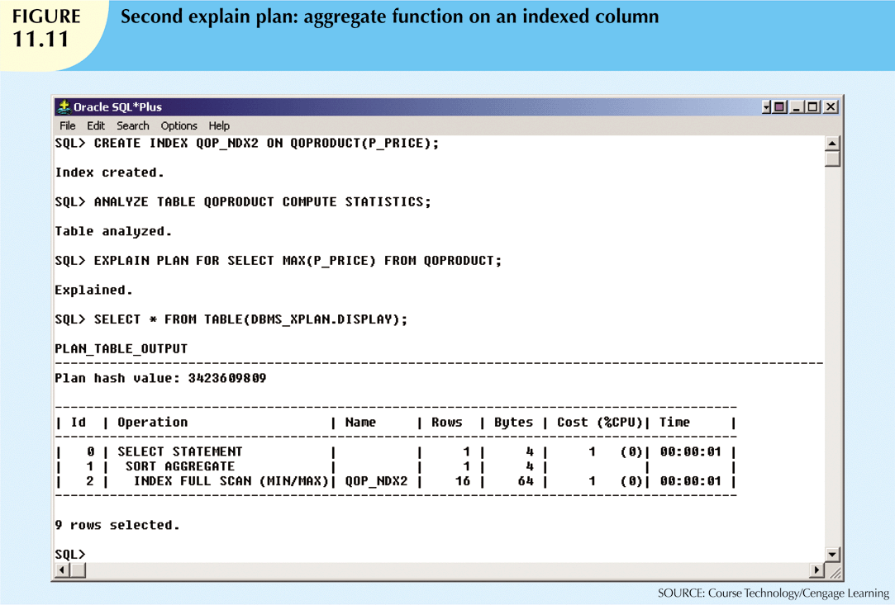
Database Systems, 10th Edition

Slide 49
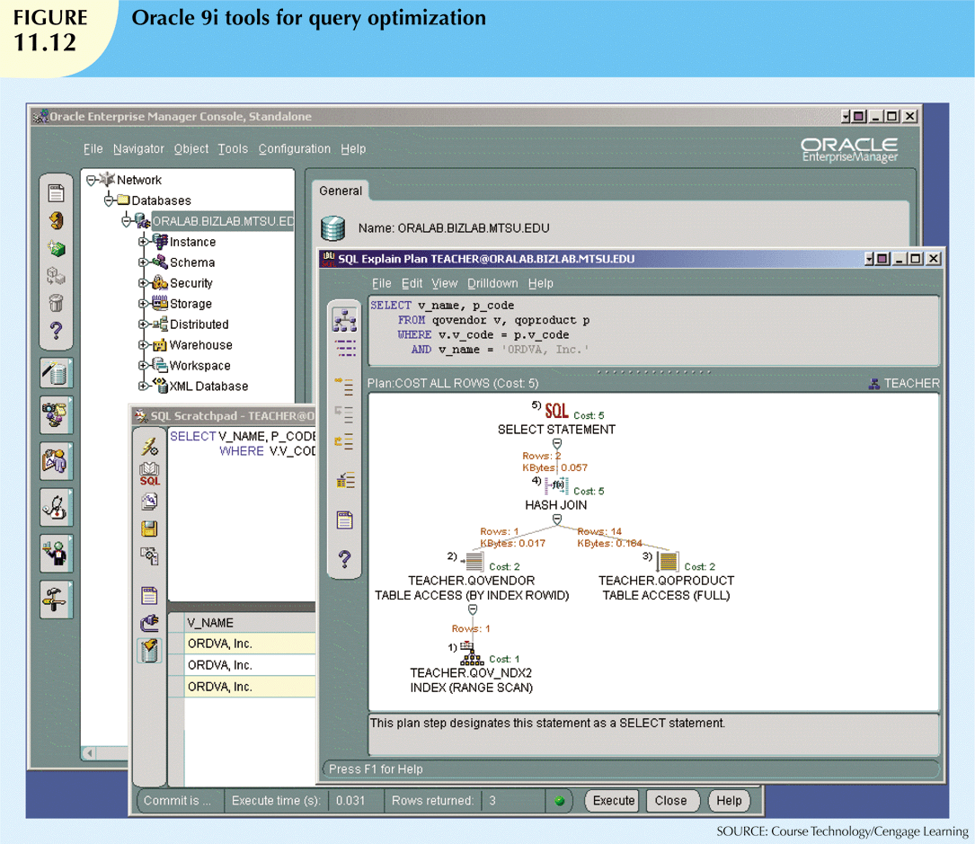
Database Systems, 10th Edition

Slide 50
Summary
Database performance tuning
  Refers to activities to ensure query is processed in minimum amount of time
SQL performance tuning
  Refers to activities on client side to generate SQL code
    Returns correct answer in least amount of time
    Uses minimum amount of resources at server end
DBMS architecture is represented by processes and structures used to manage a database
Database Systems, 10th Edition

Slide 51
Summary (cont’d.)
Database statistics refers to measurements gathered by the DBMS
  Describe snapshot of database objects’ characteristics
DBMS processes queries in three phases: parsing, execution, and fetching
Indexes are crucial in process that speeds up data access
Database Systems, 10th Edition

Slide 52
Summary (cont’d.)
During query optimization, DBMS chooses:
  Indexes to use, how to perform join operations, table to use first, etc.
Hints change optimizer mode for current SQL statement
SQL performance tuning deals with writing queries that make good use of statistics
Query formulation deals with translating business questions into specific SQL code
Database Systems, 10th Edition

